Slide 1
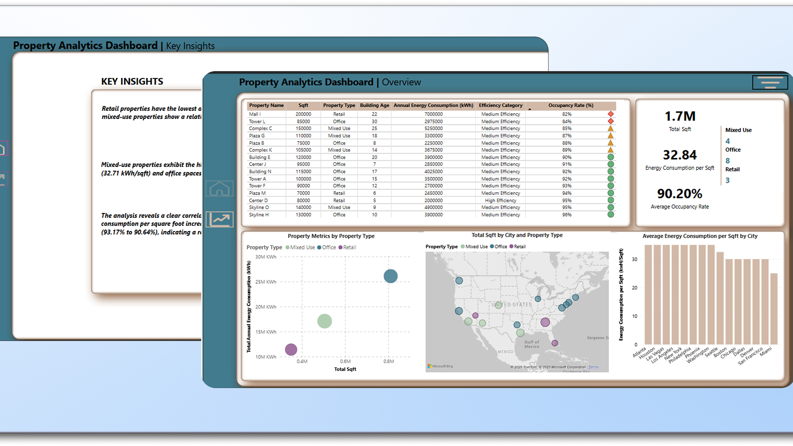
Property analytics DASHBOARD
MS OMKAR

Slide 2
Tools Used
MS Excel: Preliminary analysis
Power BI: DAX models and data visualization
Figma: Designing and prototyping the wireframe

Slide 3
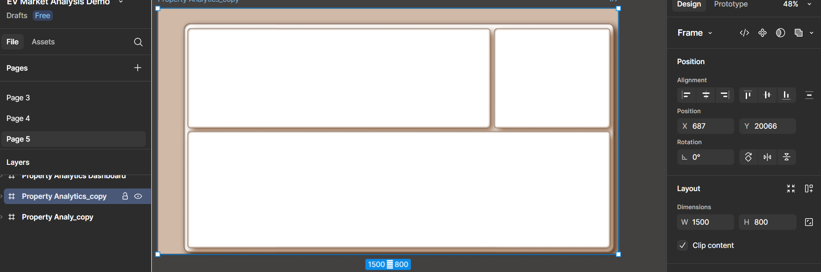
Dashboard Design & Prototyping
Utilized Figma to incorporate the required color theme and build a canvas tailored to property analytics.
Designed custom icons and layout for a professional look and feel.

Slide 4
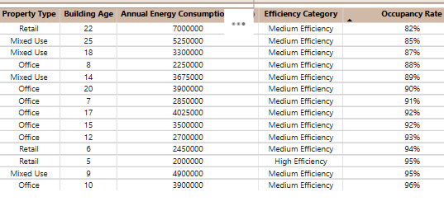
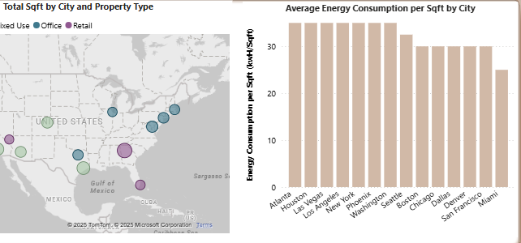
Key Visuals & Features (1)
Table with Conditional Formatting
Scatter Plot: Annual Energy Consumption vs. Sqft., Building Age as size, Property Type as color.
Map Visualization: Locations of properties with marker size representing Sqft.
Column Chart: Average energy consumption per sqft by city.

Slide 5
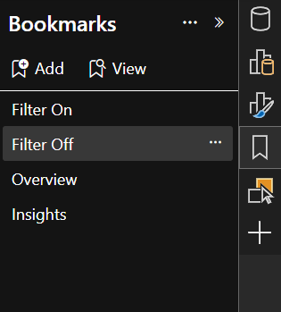
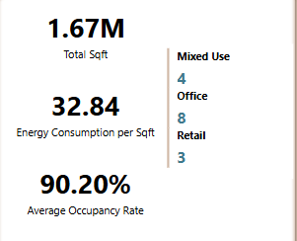
Key Visuals & Features (2)
BOOKMARK & NAVIGATION: Interactive filtering and smooth navigation.
CARD: Total Sqft, Average Occupancy Rate, Count by Property Type.

Slide 6
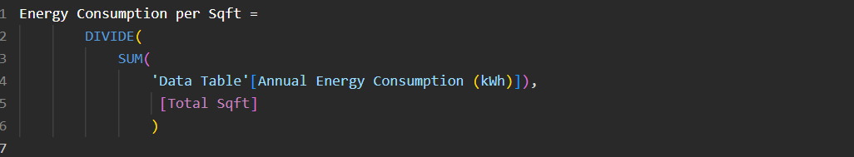
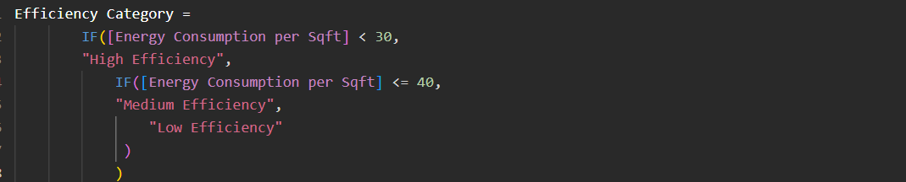
DAX & Technical Highlights
Total Sqft
Avg Building Age
Energy Consumption per Sqft
Efficiency Category (calculated column)

Slide 7
Key Insights
1.
2.
3.
Retail properties are the newest (11 years avg. age) despite having the smallest footprint, while mixed-use properties are older (16.5 years).
Mixed-use properties consume the most energy per sqft. (33.91 kWh), exceeding retail (32.71) and offices (32.22), even though offices have the largest total area.
Center D (5 years old) is the most efficient.

Slide 8
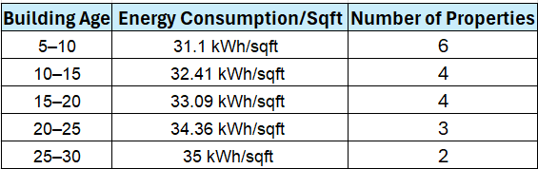
4.
Older buildings correlate with higher energy use and lower occupancy (e.g., 5–20-year-old buildings use 32.72 kWh/sqft vs. 31.10 for 5–10-year-olds, with occupancy dropping from 93% to 91%).

Slide 9
Challenges & Solutions
Challenge
Challenge: Limited data-adding more visuals/pages risked redundancy.
Solution
Focused on the most relevant KPIs and used clear formatting to maximize insights on a single page.

Slide 10
Conclusion & Next Steps
Scalability
Expand to larger datasets and add more granular data (e.g., floor or tenant level).
Role-Based Views
Create filtered versions for different stakeholders (e.g., facility managers, sustainability teams).
Data Enrichment
Integrate JLL’s market benchmarks and add basic financial metrics (e.g., operational cost per sqft.) for deeper analysis.

Slide 11
Thank You / Q&A
MS OMKAR
+918590066332
msomkar195@gmail.com

